Slide 1
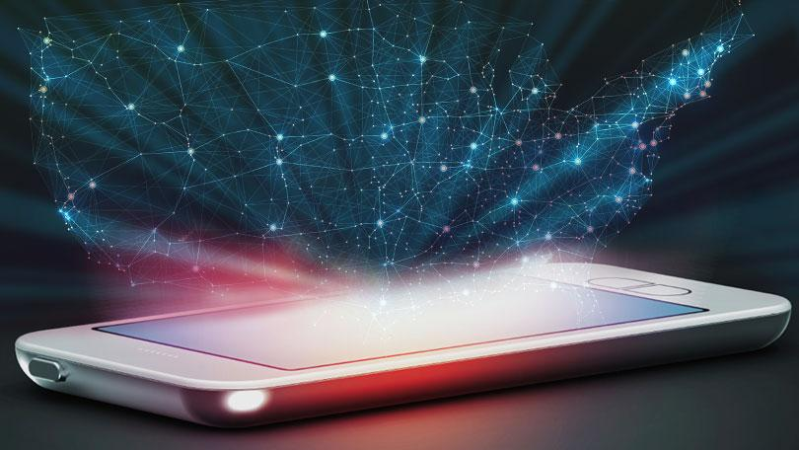
ANALYSIS OF AMAZON CELL
PHONE REVIEWS
Team members:
*Anantha Priya K
*Dhivyabharathi S
*Jaiswathika J
* Monetta K

Slide 2

DESCRIPTION:
*90 percent of the consumers read online reviews before they decide to purchase any Mobile phone from the web.
*Amazon is one of the best mobile applications and their review system is accessible across all channels presenting reviews in an easy-to-use format.
*So , There should be a system which analyses thousands of reviews of unlocked mobile phones sold on Amazon.com to find insights with respect to reviews, ratings, price and their relationships

Slide 3
STEPS INVLOVED:
DATA COLLECTION:
01
Mobile phone review dataset is collected.
TEXT PREPROCESSING:
02
Import the dataset , remove punctuations, numbers, convert each word into its lower case, apply stemming, splitting data into training and test set.
MODEL BUILDING:
Importing the model , building libraries , initializing the model , adding input layer , hidden layer and output layer , configuring the learning process , training and testing the model , optimize the model , and save the model.
03
APPLICATION BUILDING:
04
Creating a HTML file and building a python code.

Slide 4
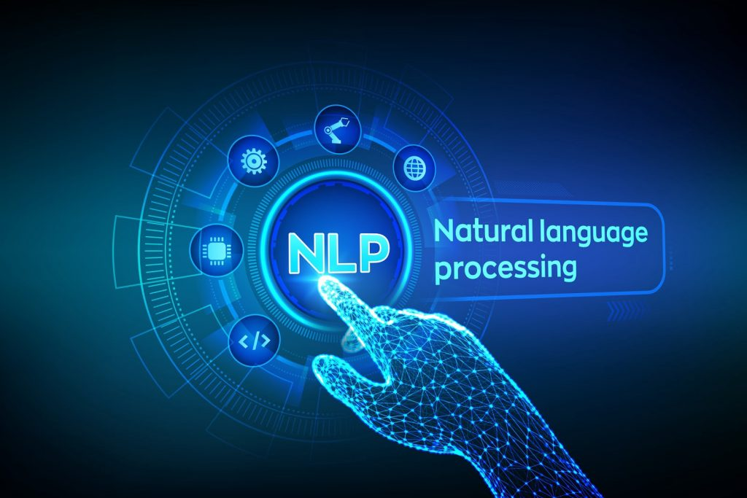
TECHNOLOGY USED:
*Deep learning-NLP(Natural language Processing)
NLP is used to program computers to process and analyze large amounts of natural language data.
*Machine learning
*Python
FOR WEB DEVELOPMENT:
*HTML-Hyper Text Markup Language
*CSS-Cascading Style Sheets
*JavaScript

Slide 5

01
#Data is
collected
from online resources.
DATA
COLLECTION

Slide 6

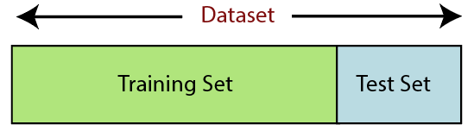
02 DATA PREPROCESSING
*Import the dataset, and using libraries like pandas and numpy remove the punctuations and numbers
*Remove unwanted data like name , data
*Remove null values.
*Remove the regular expressions.
*Convert each word into its lower case.
*Apply stemming(to remove stop words)
*Using rating we convert them into binary.
*If rating is >= 3 , then the data is POSITIVE.
*If the rating is < 3, then the data is NEGATIVE.

Slide 7
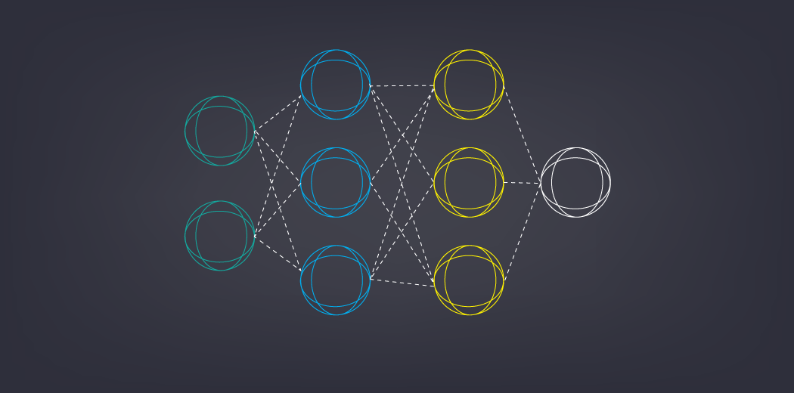
03 MODEL BUILDING
* Initialize the model , add input layer , hidden layer and output layer.
* Configure the learning process , train and test the model , optimize the model.
* Predict the model by giving Inputs.
*Save the model.
*Accuracy of our model is 0.957

Slide 8
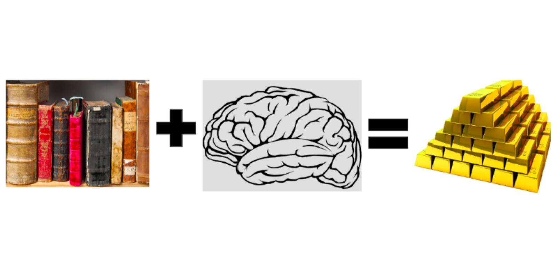
04 APPLICATION BUILDING
Creating a HTML file and building a python code Using FLASK.

Slide 9

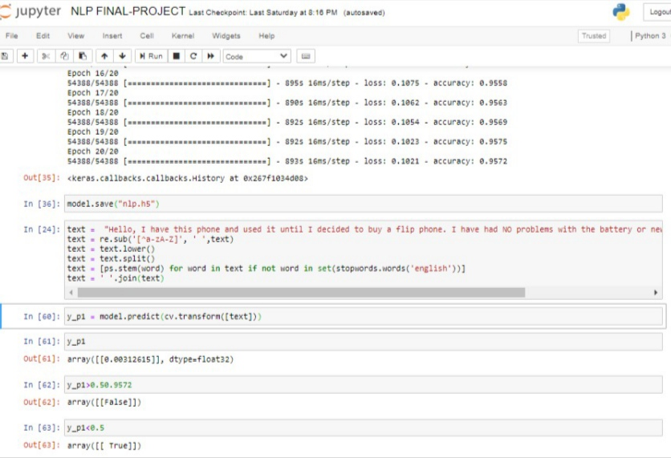
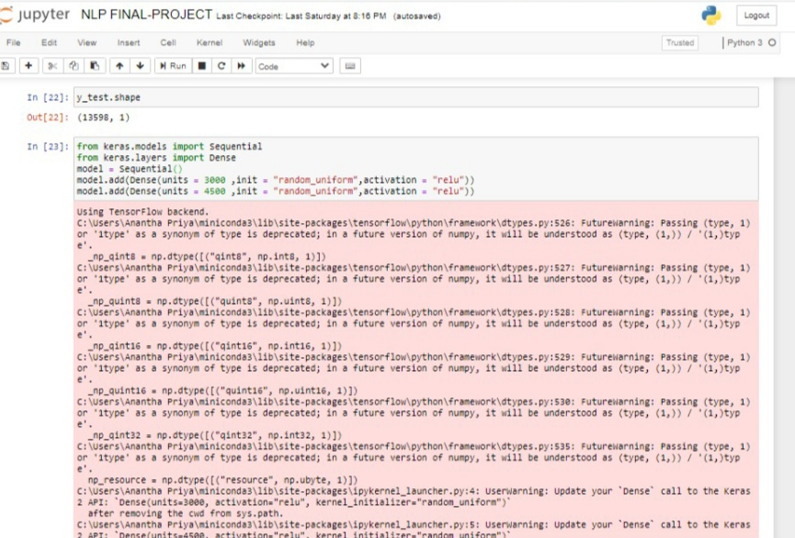
OUR MODEL:

Slide 10

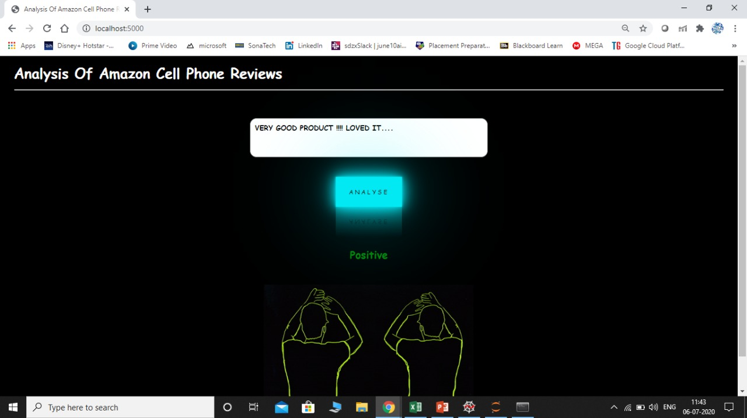
OUR UI:
THIS IS A POSITIVE
REVIEW

Slide 11
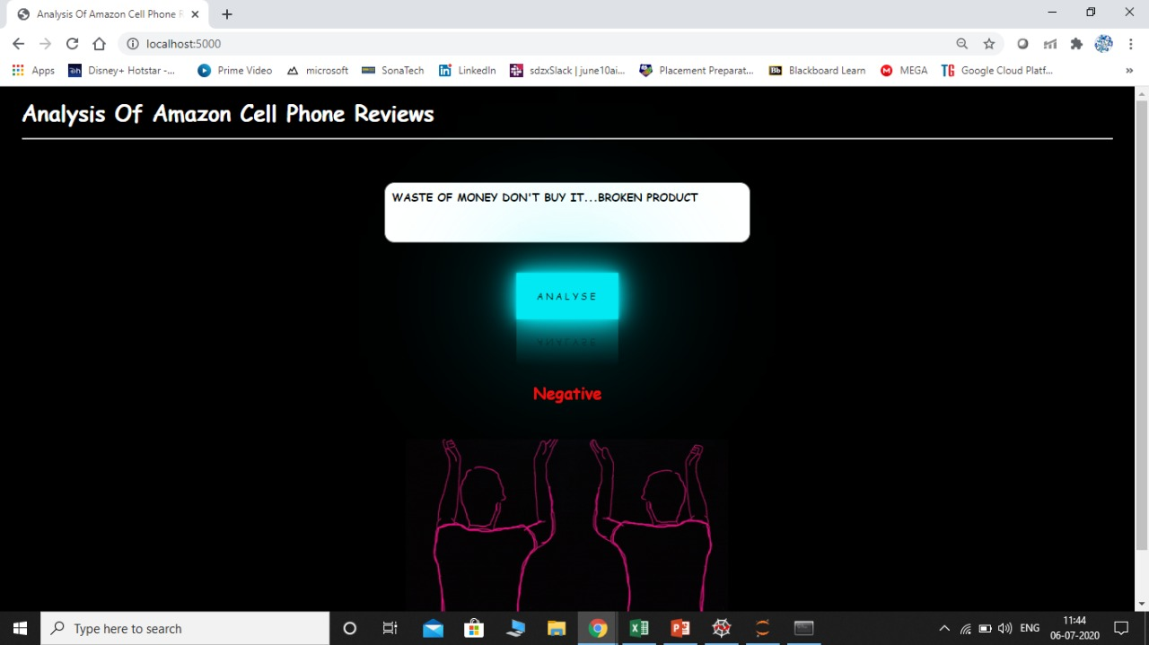
OUR UI:
THIS IS A NEGATIVE
REVIEW

Slide 12
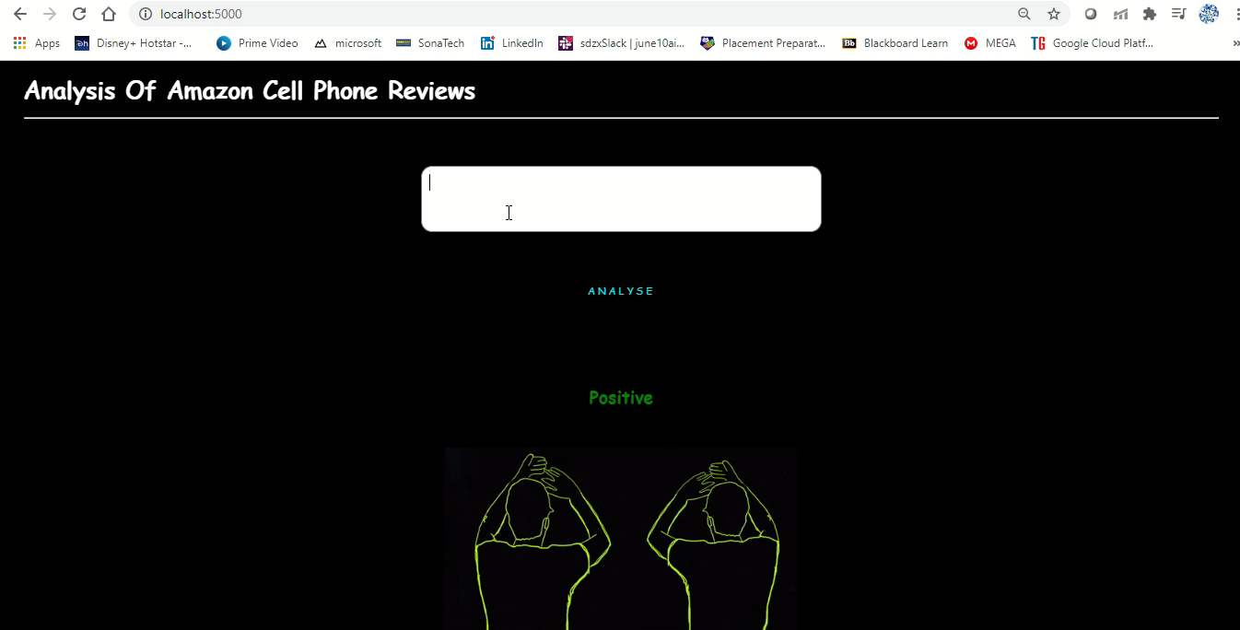
OUR DEMO VIDEO

Slide 13

THANK YOU

